Slide 1
Doors and Corridors
Calculate the minimum size of doors and corridors
Identify the features of doors and corridors

Slide 2
Historic Fire
Hartford Hospital

Slide 3
Minimum Widths
NFPA rules
IBC rules

Slide 4
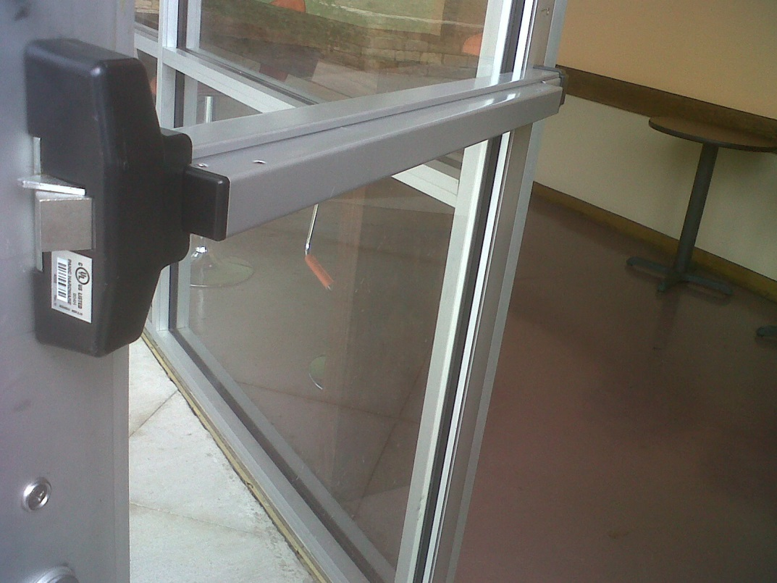
Doors
Direction
Hardware
Locks
  Delays
Forces
Labels

Slide 5
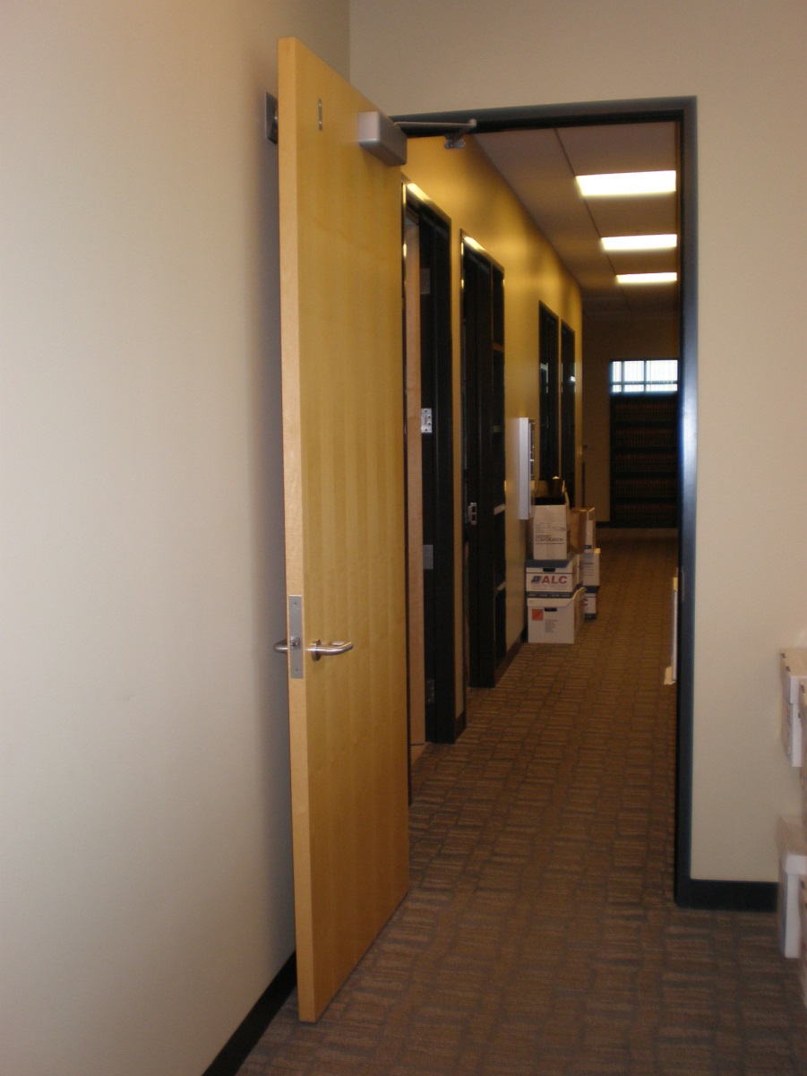
Doors
Automatic-closing
Self-closing
Level
  Width of leaf on either side
Egress side
Ingress side

Slide 6
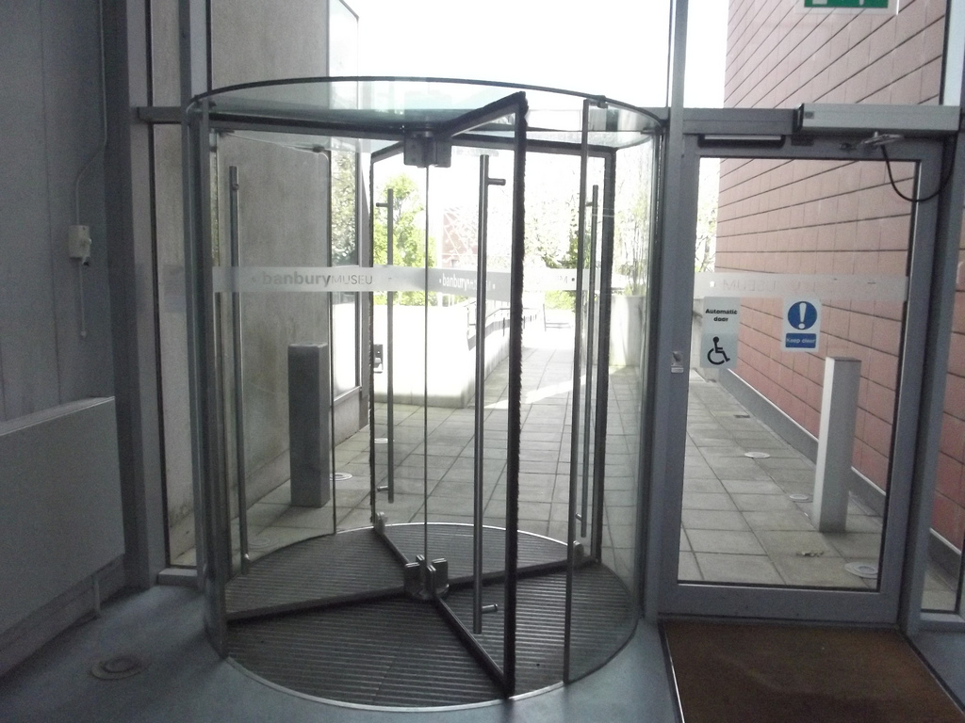
Revolving Doors
Typically not include in means of egress
Must have regular doors adjacent
Doors must break-away in direction of travel
Rules on speeds

Slide 7
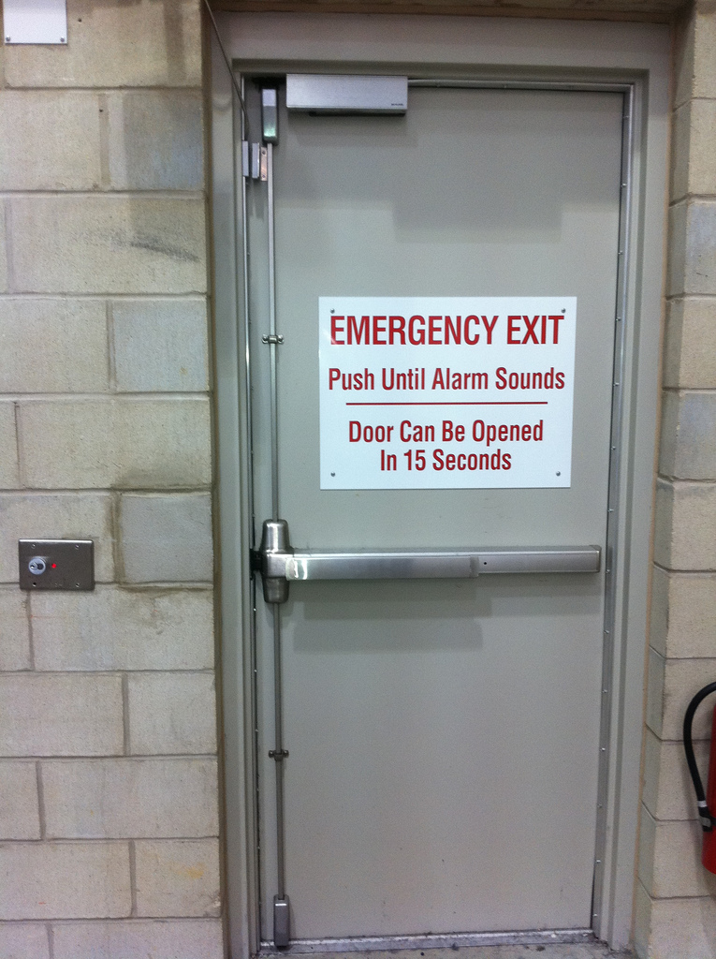
Doors
Single action
  No special knowledge
  No special tools
Lock side based on security

